Slide 1
CST2550 - 2025
Software Engineering and Management
Week 5: Introduction to Database and SQL
Ahmed Eissa
a.eissa@mdx.ac.uk

Slide 2
Learning Objectives
Understand database fundamentals.
Master SQL query basics.
Design efficient database schemas.

Slide 3
1. Database Concepts

Slide 4
Relational Database Fundamentals
Tables and Relationships
  Tables: Collections of rows and columns used to store data.
  Relationships: Logical connections between tables based on data.
    One-to-One, One-to-Many, Many-to-Many.
Primary and Foreign Keys
  Primary Key: A unique identifier for a record in a table.
  Foreign Key: A field in one table that references the primary key in another table.
Normalisation Principles
  Process of organising data to reduce redundancy and improve integrity.
  Normal Forms:
    1NF: Eliminate duplicate columns and create separate tables for related data.
    2NF: Ensure that all non-key attributes depend on the whole primary key.
    3NF: Eliminate transitive dependencies (non-key attributes depending on other non-key attributes).

Slide 5
Database Design
Entity-Relationship (ER) Diagrams
  Visual representation of data and relationships.
  Components:
    Entities: Represent objects or concepts (e.g., Students, Courses).
    Attributes: Details about entities (e.g., Name, Age).
    Relationships: Connections between entities (e.g., Students Enrol in Courses).
Schema Design
  Logical structure of a database.
  Includes tables, fields, data types, and constraints.
Indexing Strategies
  Improve query performance by reducing data retrieval time.
  Types:
    Clustered Index: Sorts and stores rows physically in the table.
    Non-clustered Index: A separate structure pointing to the data.

Slide 6
2. SQL Fundamentals

Slide 7

SQL Structure: DDL, DML, and DCL
Data Definition Language (DDL)
  Used to define and manage database structure.
  Example:
Data Manipulation Language (DML)
  Used to manipulate data within the database.
  Example:
Data Control Language (DCL)
  Used to control access to data.
  Example:

Slide 8
Basic SQL Operations
SELECT Statements
  Retrieve specific columns and rows from a table.
  Example:
INSERT, UPDATE, DELETE
  INSERT: Add new rows to a table.
  UPDATE: Modify existing records.
  DELETE: Remove records from a table.

Slide 9

Basic SQL Operations
3. JOIN Operations
  Combine rows from two or more tables based on related columns.
  Types:
    INNER JOIN: Returns matching rows.
    LEFT JOIN: Returns all rows from the left table and matching rows from the right table.
    RIGHT JOIN: Returns all rows from the right table and matching rows from the left table.
    FULL OUTER JOIN: Returns all matching and non-matching rows from both tables.
  Example:

Slide 10
Basic SQL Operations
4. WHERE Clauses and Filtering
  Specify conditions to filter data.
  Example:

Slide 11
Summary and Q&A
Database Fundamentals: Tables, keys, and normalisation principles.
SQL Basics: SELECT, JOIN, and other operations.
Schema Design: ER diagrams and indexing strategies.

Slide 12
Discussion Questions:
How do you choose between clustered and non-clustered indexes?
What are the advantages of normalisation?
When might denormalisation be preferred over normalisation?

Slide 13
Practical Examples

Slide 14
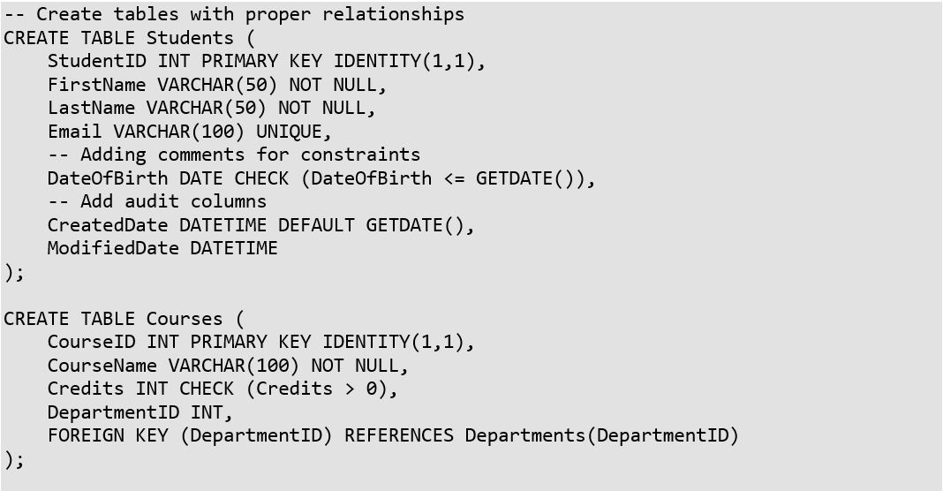
Example 1: Database Design and
Basic SQL

Slide 15
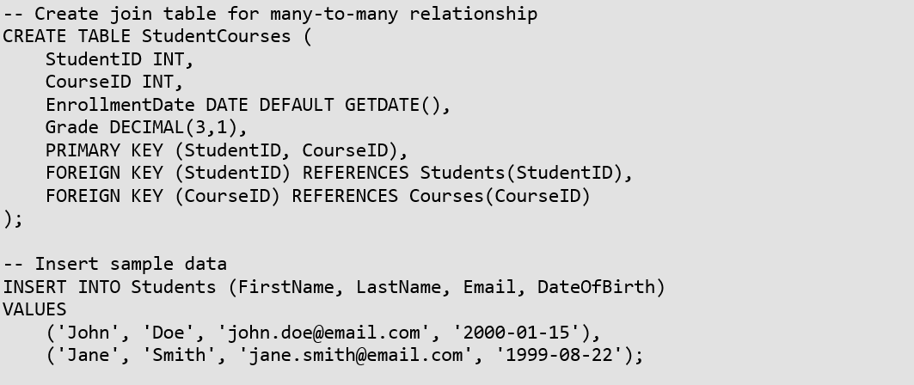
Example 1: Database Design and
Basic SQL

Slide 16
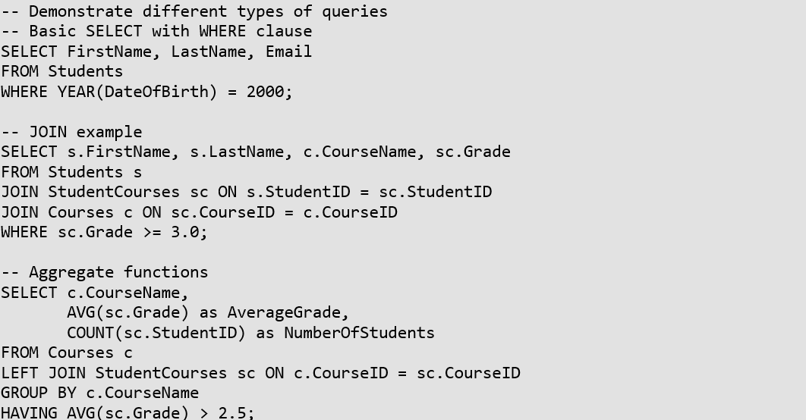
Example 1: Database Design and
Basic SQL

Slide 17
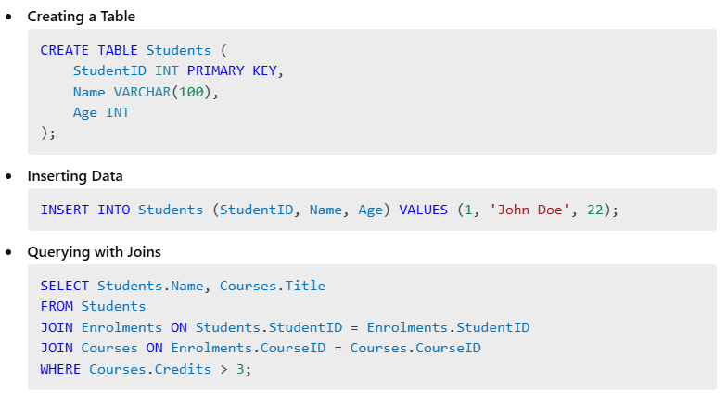
Example 2

Slide 18
Further Reading
Books:
  "Database System Concepts" by Abraham Silberschatz, Henry Korth, and S. Sudarshan.
  "SQL in 10 Minutes, Sams Teach Yourself" by Ben Forta.
Online Resources:
  W3Schools SQL Tutorial
  Khan Academy: Intro to SQL
  SQLZOO Interactive SQL Tutorials
Documentation:
  MySQL Documentation
  Microsoft SQL Server Documentation
  PostgreSQL Documentation

Slide 19
Next Week
Week 6: Implementing Database in C# Applications

